Slide 1

Floral biodiversity estimation of grasslands in Franconia using Sentinel-2
19.03.2024
Laura Obrecht
Notes:
Grasslands cover one third of the Earth‘s terrestrial surface, second largest terrestrial carbon sink, host high levels of biodiversity
→ As big this area as great is the variance between grasslands
Relationship of biodiversity and Biomass (critical for fodder production, ecosystem services) poorly understood
Introduction
Reason why the project of Sophie is interessted in assessing not only biomass production, mowing events etc but also biodiversity across pre-alpine grasslands
Started working on it in April, more data which considerably improved the results of the biodiversity estimation

Slide 2
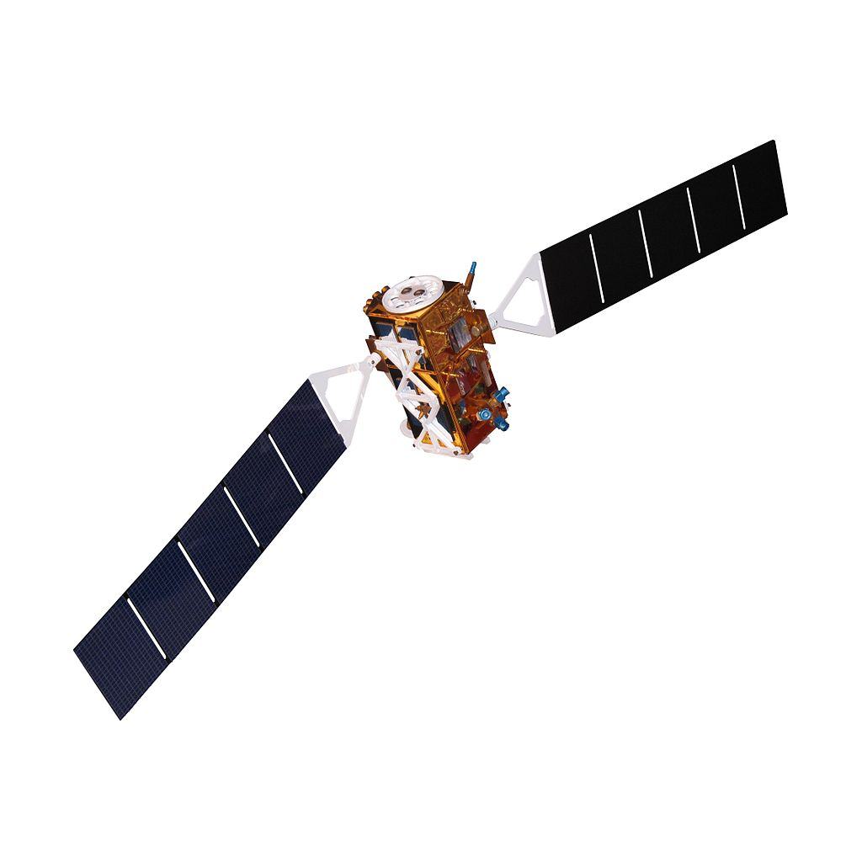
Topics
Method, Workflow
Study Sites
Influence of Mowing Events on Prediction
Quality of Random Forest Prediction
Prediction of Species Richness into Space
Outlook

Slide 3
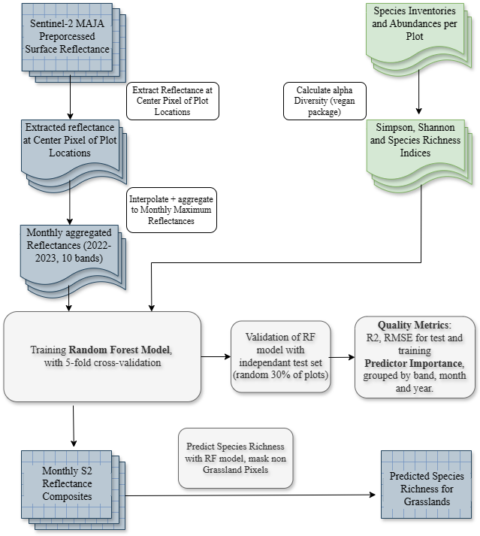
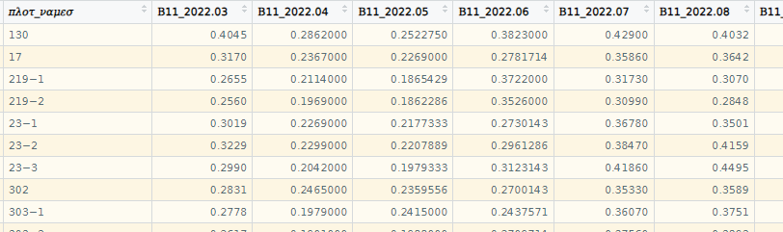
Workflow
Figure. Monthly aggregated Reflectance (2022-2023), input to Random Forest. (Screenshot from RStudio)
Random Forest
+ no problems with the weighting of predictors
+ user-friendly, easy to implement
Monotemporal Species Inventories
→ Expectable Overall Species Richness (no phenology)
Notes:
Prediction on Pixel Scale
Seed erklären, Wiederholungen jedes Modells
DataFrame nochmal neu machen, Biodiv Variable sichtbar
Welche Monate genutzt drauf eingehen

Slide 4
Response Variable
Alpha Diversity
Species inventories sampled mono-temporal in May 2022 and April 2023
Species Number (specn) closest to „Normalverteilung“
Best Response Variable, followed by Shannon Index
Notes:
Definition of alpha diversity

Slide 5
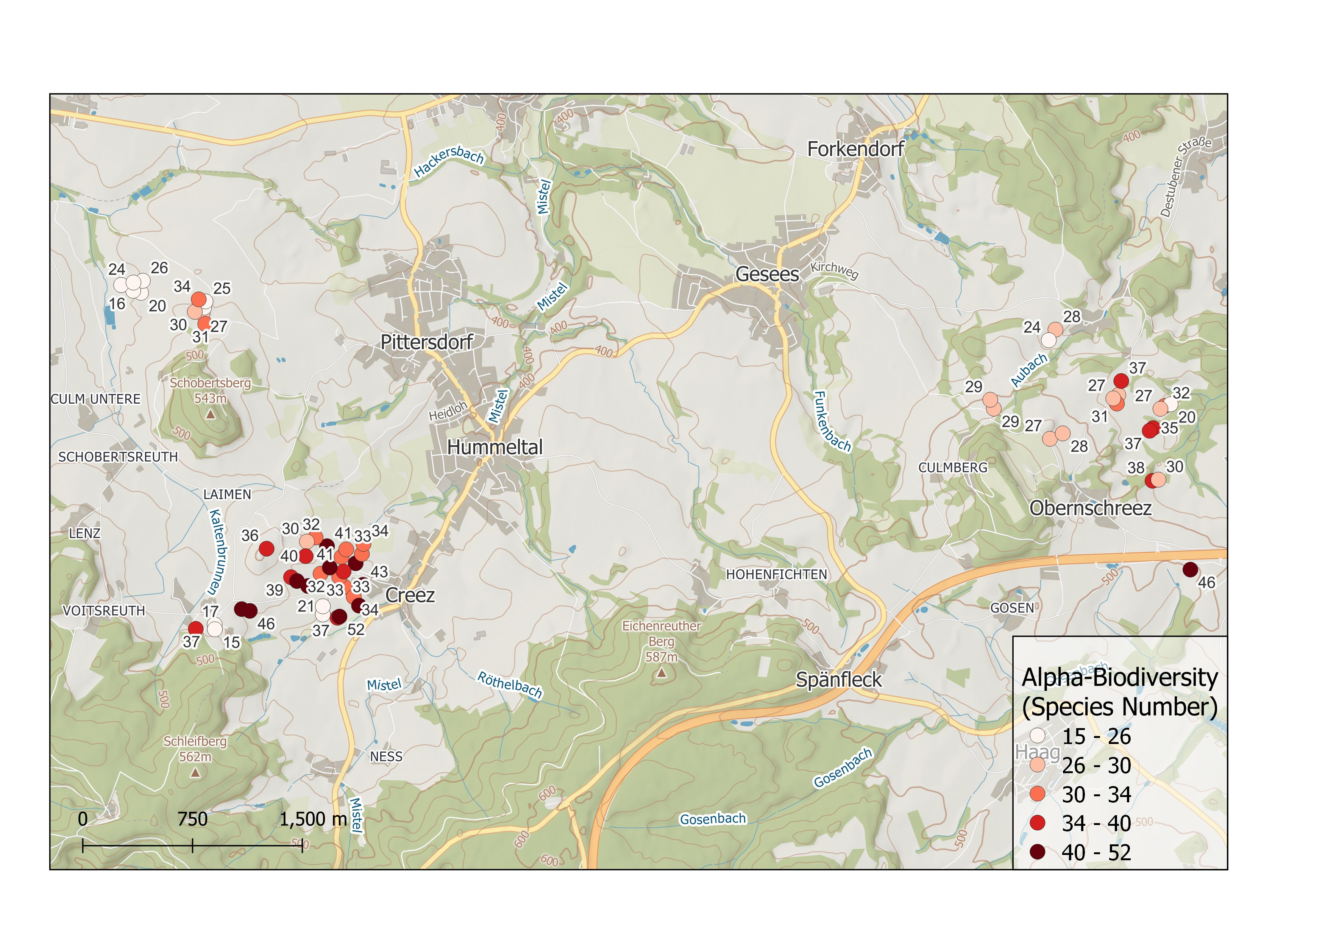
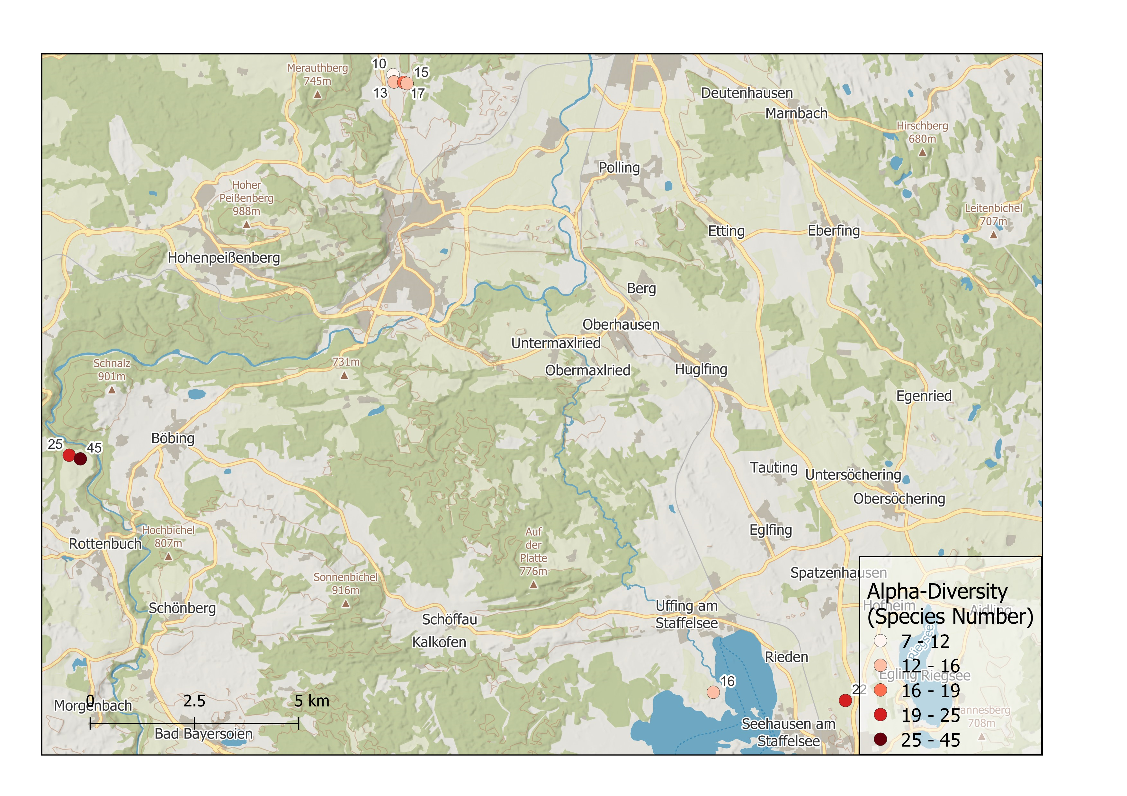
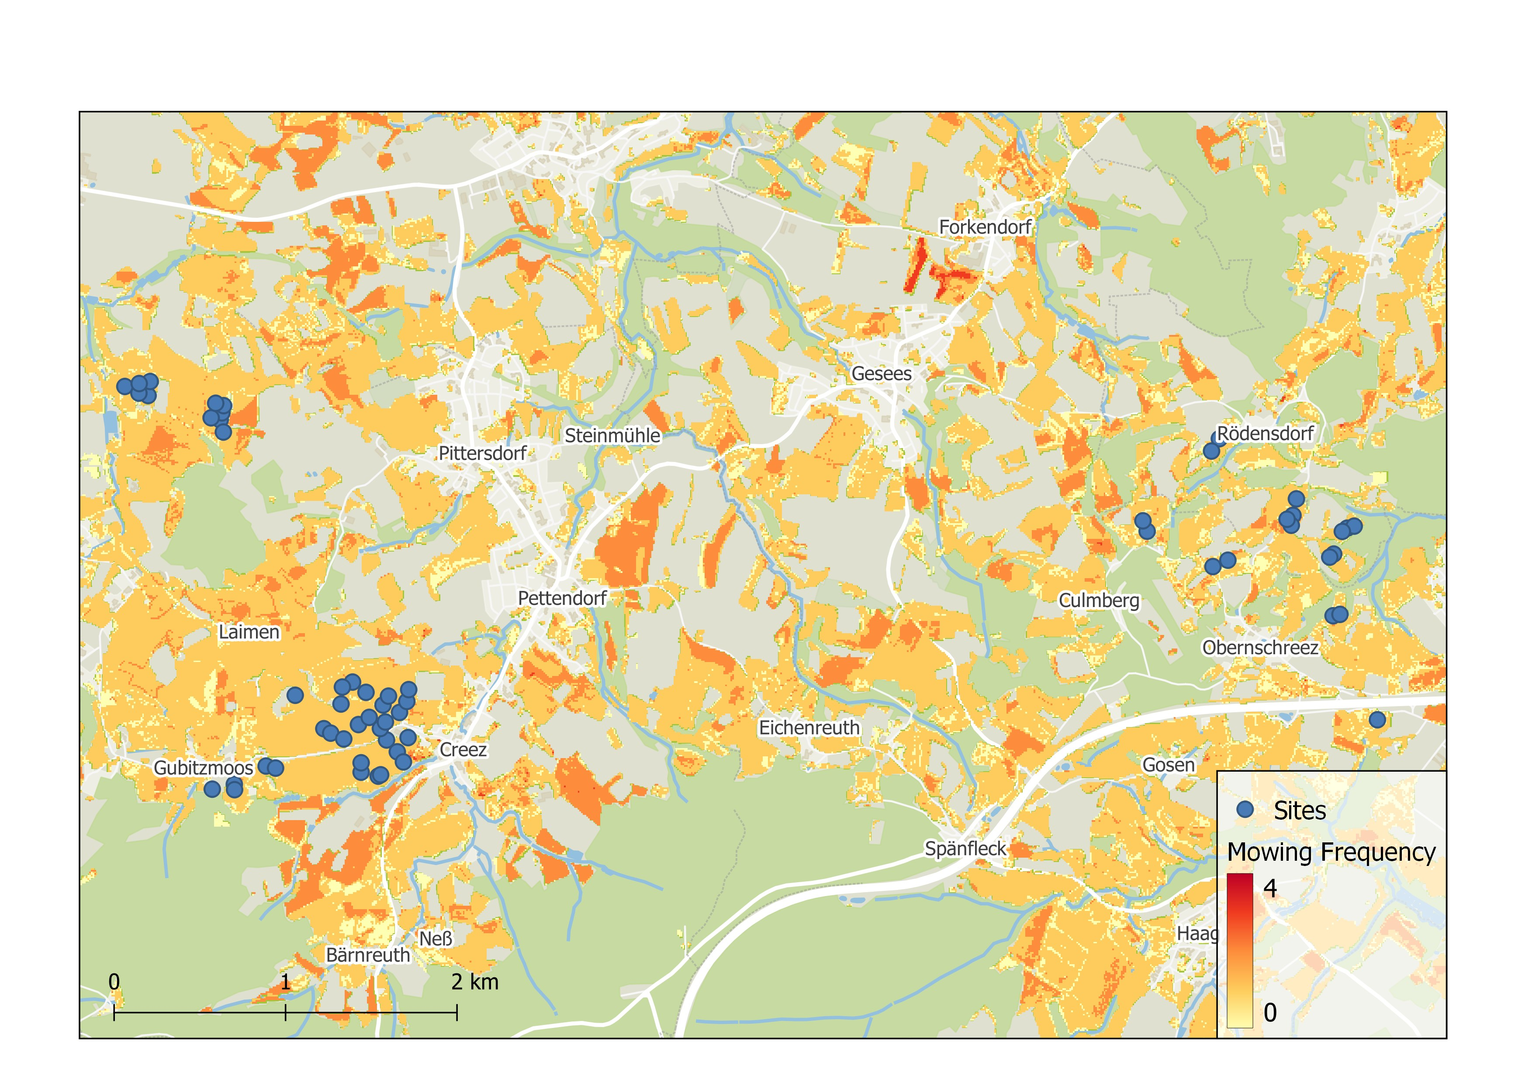
Study Sites
Random Forest Predictors
Training and Testing with data from Lower Franconia
Training and Testing with data from Lower Franconia and Ammer Catchment
Mowing Frequency, DOY of first Cut as additional Predictors
Notes:
Karten Untersuchungsgebiet (QGIS), Plot von Mowing Raster als Motiv
Duplicate Slide to present results for different cases in the end

Slide 6
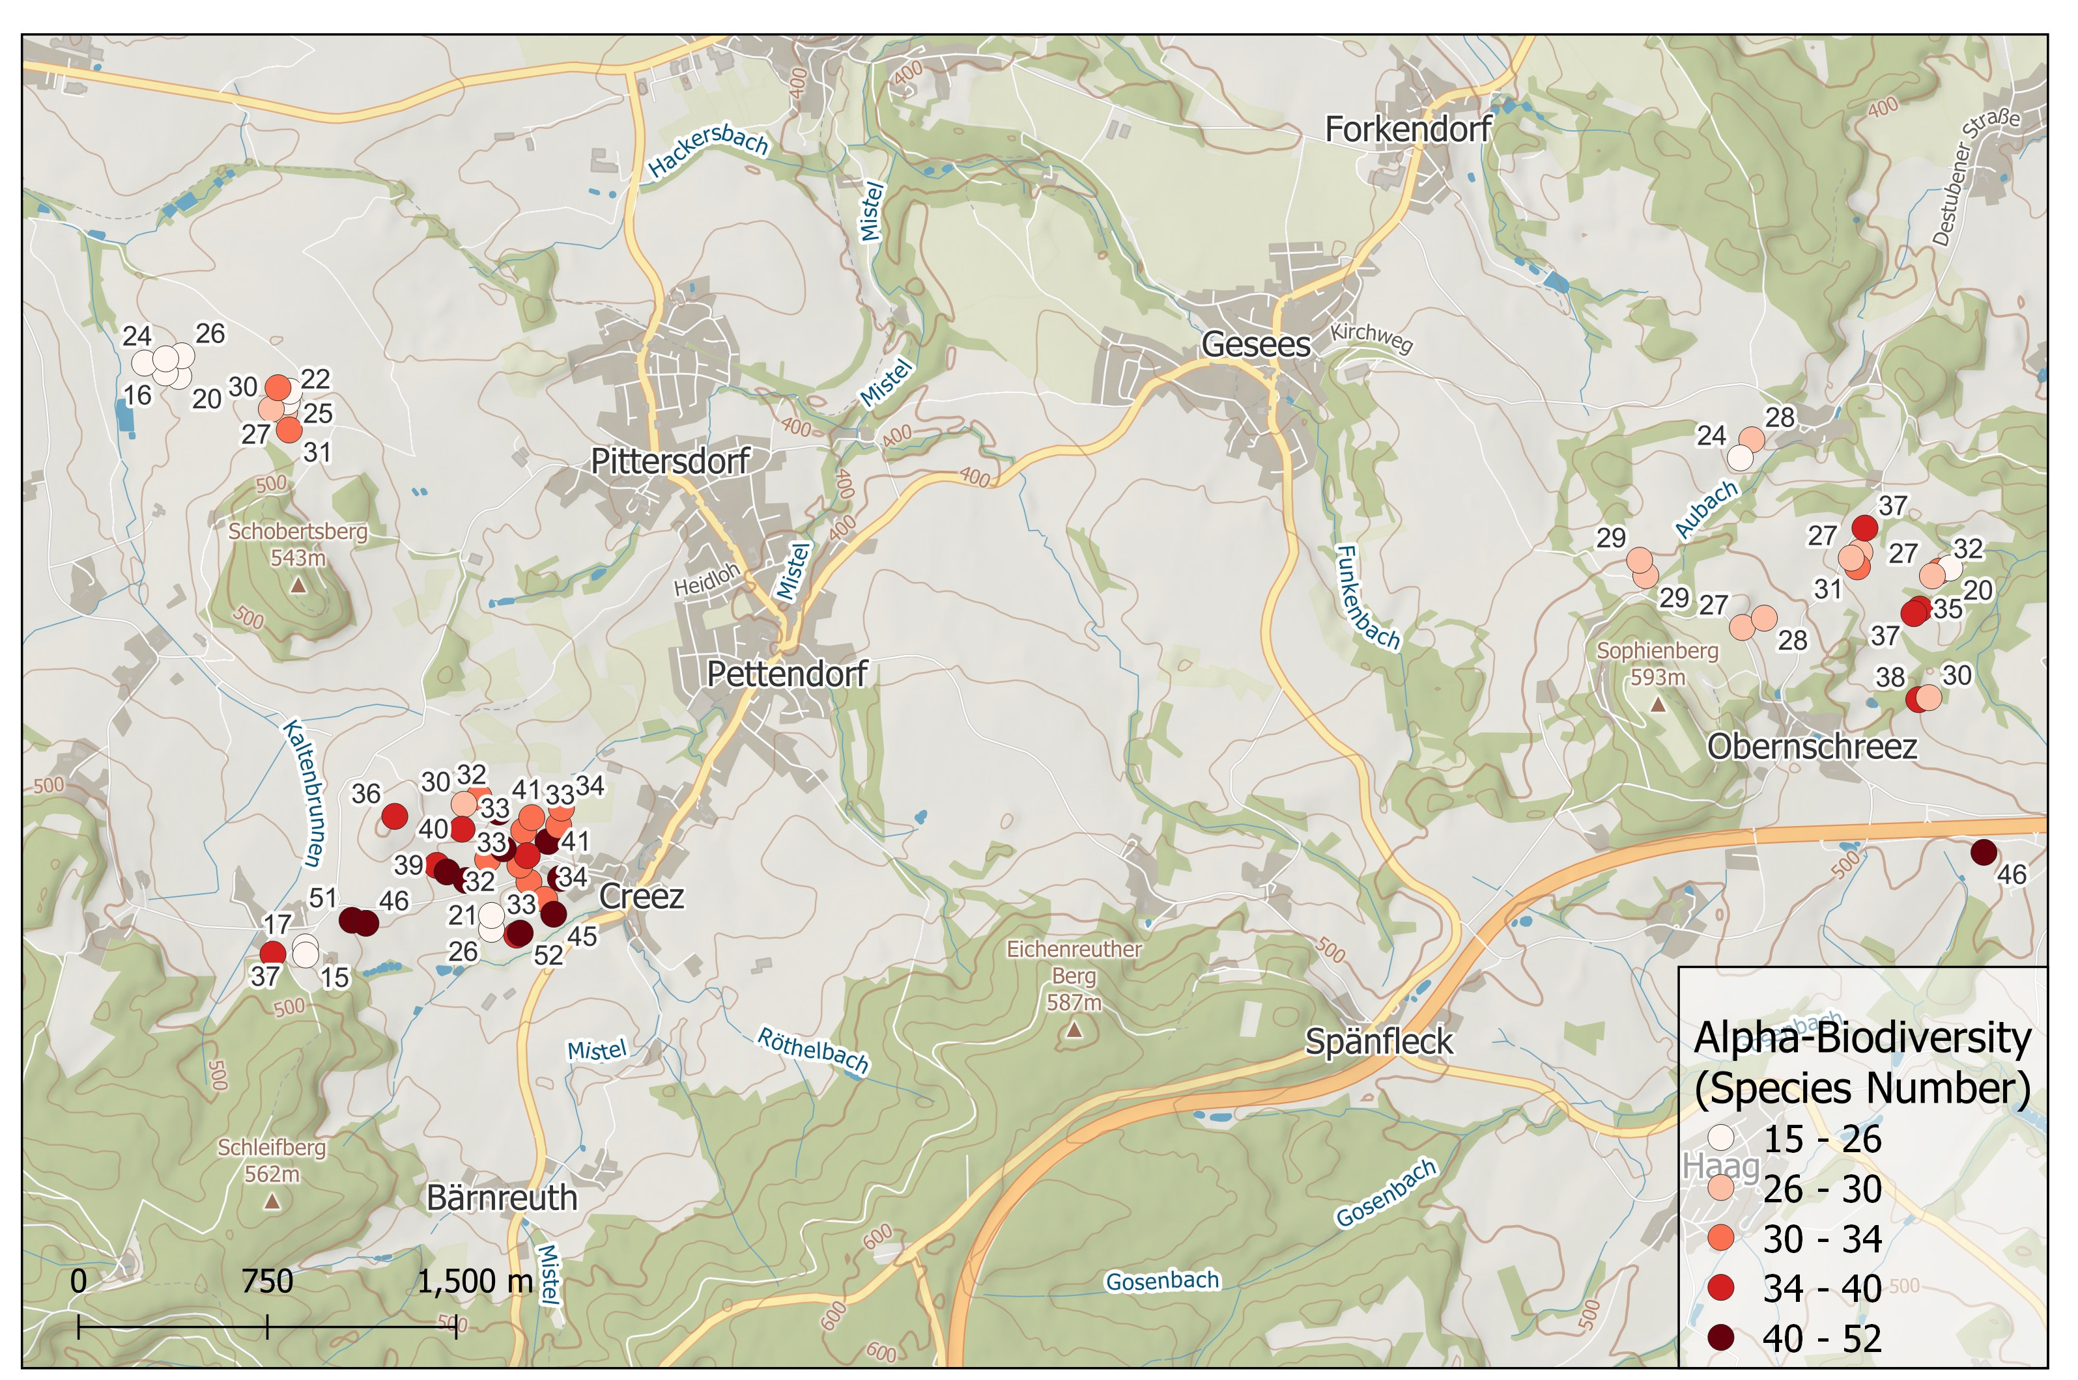
Notes:
Grid, Nordpfeil, Übersicht Bayern
Alpha Diversity

Slide 7
Study Sites
Random Forest Predictors
Training and Testing with data from Lower Franconia
Training and Testing with data from Lower Franconia and Ammer Catchment
Mowing Frequency, DOY of first Cut as additional Predictors
Notes:
Karten Untersuchungsgebiet (QGIS), Plot von Mowing Raster als Motiv
Duplicate Slide to present results for different cases in the end

Slide 8


Slide 9
Study Sites
Random Forest Predictors
Training and Testing with data from Lower Franconia
Training and Testing with data from Lower Franconia and Ammer Catchment
Mowing Frequency, DOY of first Cut as additional Predictors
Notes:
Karten Untersuchungsgebiet (QGIS), Plot von Mowing Raster als Motiv
Duplicate Slide to present results for different cases in the end

Slide 10
Notes:
Also Map of DOY of First Cut?
Jahreszahl dazu!

Slide 11
Comparison of Alpha-Diversity Indices as Response Variable
Notes:
Drei Spalten

Slide 12
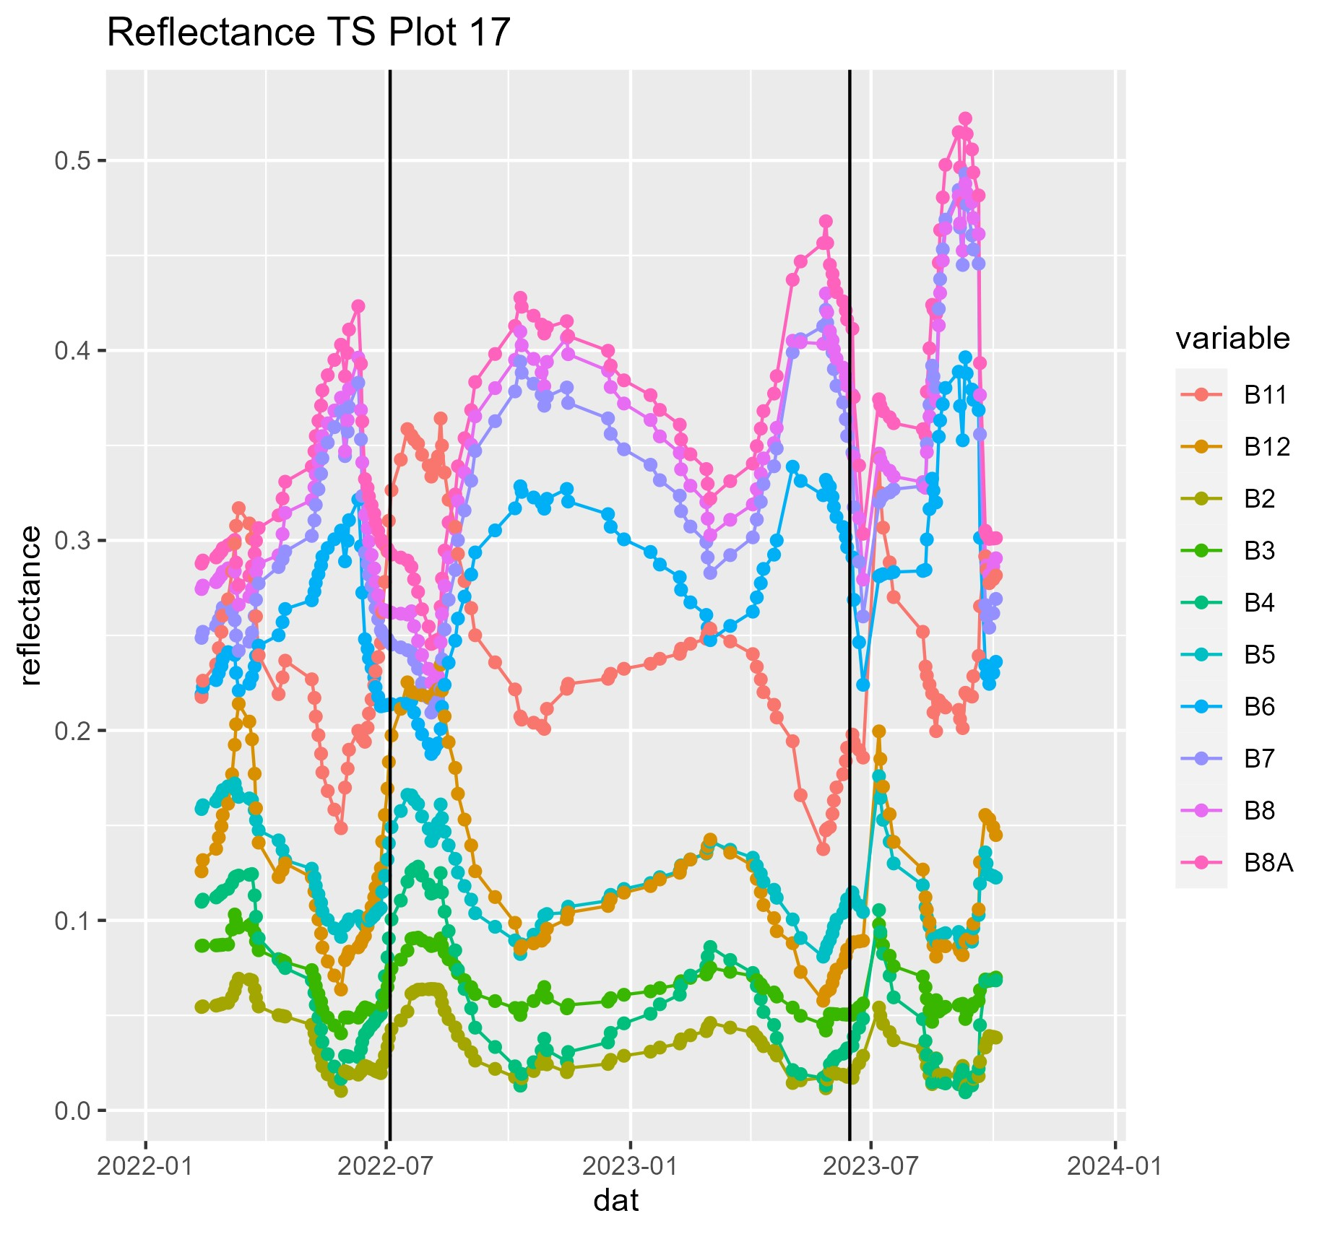
S2 Time Series extracted at Center Pixel

Slide 13
Monthly Compositing of S2 Reflectance per Band
Trend per Band after Cut
Goal is to ensure that RF is not trained/influenced by Mowing Events/Frequency
Bands increasing after mowing are composited as minimum composites, bands decreasing are composited as maximum
Notes:
Andere Farben increasing decreasing (sehr aggressiv)

Slide 14
Comparison of Compositing Methods
Predictors | Resp_var | seed | R2 | RMSE | stdev | var1 | var2 | var3
Median | specn | 75 | 0.644 | 5.399 | 0.286 | B3_2022.07 | B3_2023.08 | B11_2023.08
Median | specn | 3 | 0.68 | 5.223 | 0.261 | B4_2022.04 | B4_2022.03 | B3_2023.08
Median | specn | 87 | 0.675 | 5.714 | 0.236 | B11_2023.04 | B12_2022.03 | B4_2022.03
Median | specn | 77 | 0.734 | 5.443 | 0.226 | B4_2022.04 | B4_2022.03 | B12_2022.03
Median | specn | 67 | 0.507 | 5.357 | 0.324 | B4_2022.04 | B3_2022.09 | B5_2022.04
Max | specn | 86 | 0.617 | 5.517 | 0.269 | B12_2023.03 | B11_2023.03 | B4_2022.04
Max | specn | 40 | 0.576 | 5.435 | 0.304 | B5_2022.03 | B4_2022.04 | B12_2022.03
Max | specn | 84 | 0.677 | 5.27 | 0.258 | B11_2023.03 | B4_2022.04 | B5_2022.04
Max | specn | 38 | 0.588 | 5.443 | 0.26 | B11_2022.04 | B4_2022.04 | B11_2023.04
Max | specn | 3 | 0.654 | 5.525 | 0.269 | B5_2022.03 | B4_2022.04 | B11_2023.03
Min | specn | 51 | 0.663 | 5.449 | 0.265 | B12_2022.03 | B12_2022.04 | B4_2022.04
Min | specn | 41 | 0.663 | 4.951 | 0.276 | B4_2023.04 | B11_2023.03 | B11_2023.04
Min | specn | 91 | 0.766 | 5.225 | 0.19 | B5_2022.09 | B12_2023.03 | B11_2023.04
Min | specn | 43 | 0.667 | 5.484 | 0.234 | B5_2022.09 | B11_2023.03 | B4_2022.04
Min | specn | 10 | 0.733 | 4.822 | 0.223 | B2_2022.03 | B4_2022.04 | B12_2023.04
MaxMinperBand | specn | 39 | 0.682 | 5.068 | 0.254 | B12_2023.06 | B3_2023.08 | B11_2023.06
MaxMinperBand | specn | 53 | 0.72 | 5.01 | 0.18 | B3_2023.08 | B5_2022.09 | B3_2023.04
MaxMinperBand | specn | 45 | 0.687 | 5.326 | 0.243 | B5_2022.09 | B3_2023.08 | B11_2023.03
MaxMinperBand | specn | 27 | 0.675 | 5.325 | 0.253 | B4_2022.03 | B3_2023.08 | B5_2023.04
MaxMinperBand | specn | 8 | 0.685 | 5.016 | 0.253 | B3_2023.08 | B12_2023.03 | B4_2023.04

Slide 15
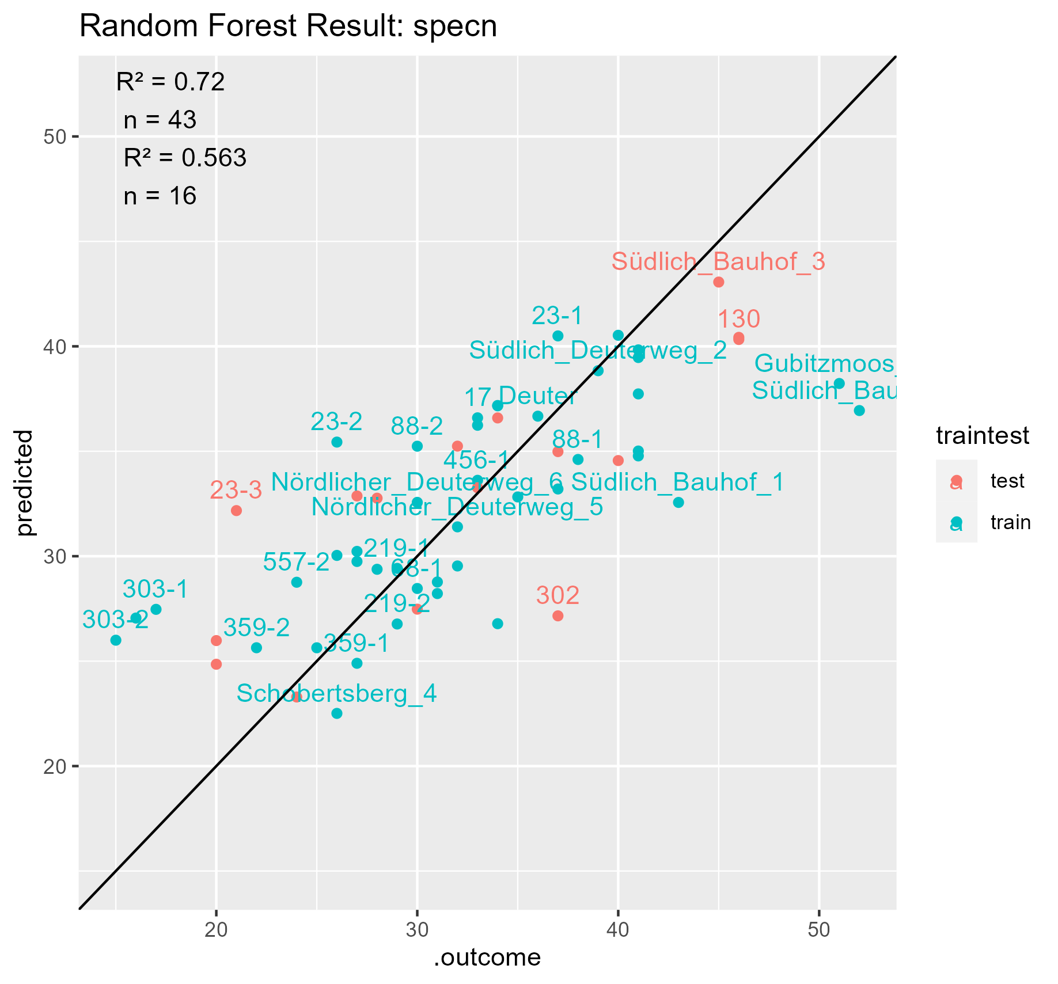
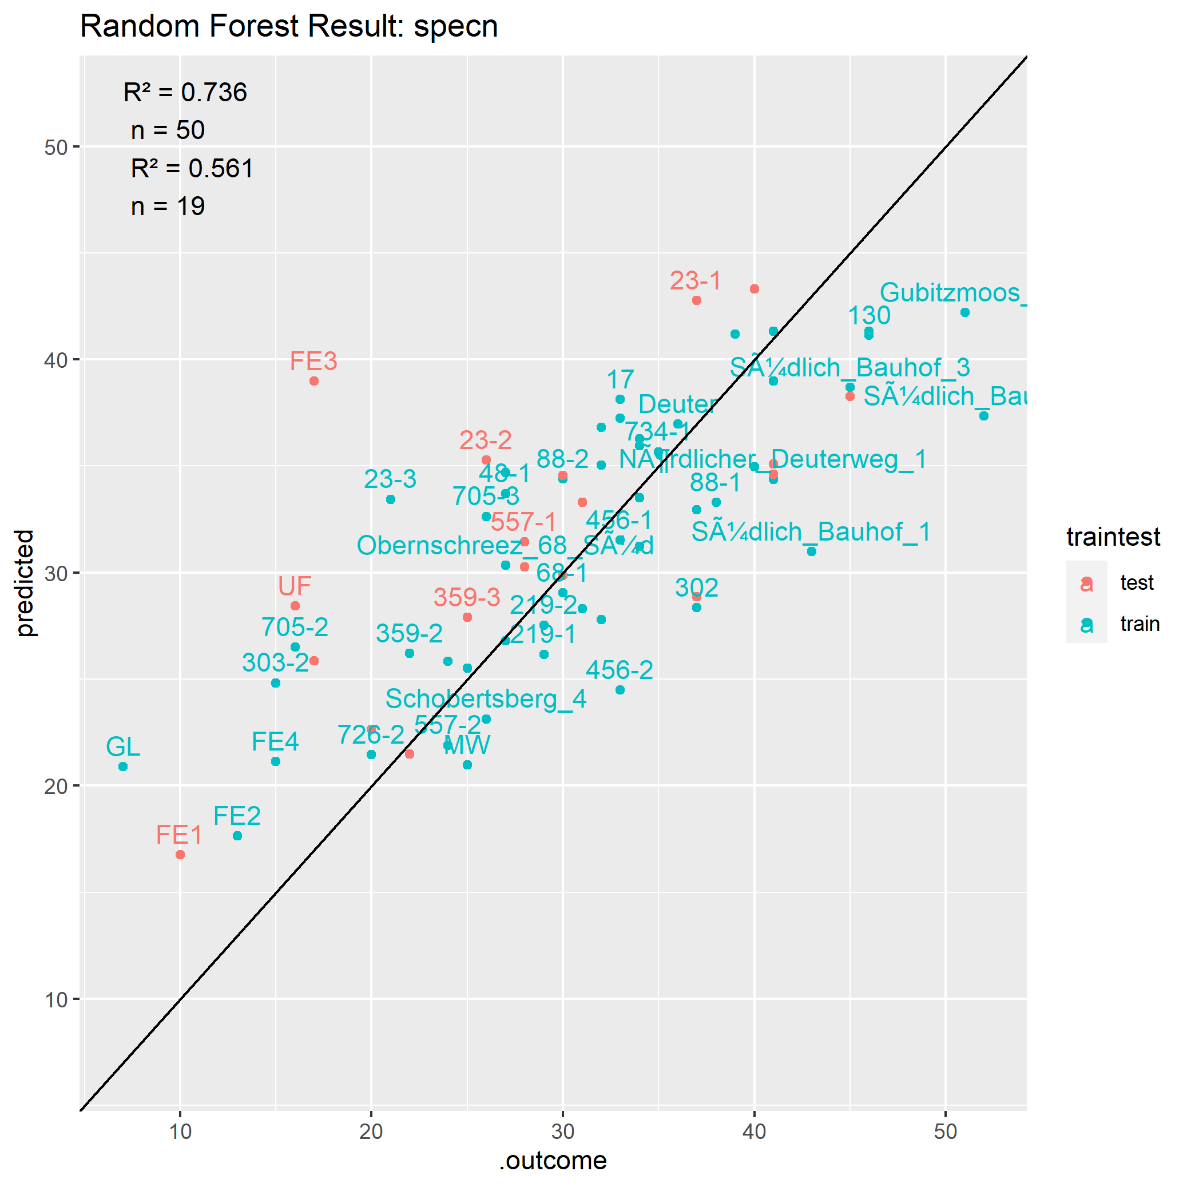
Comparison Training with and without samples from Ammer Catchment
Notes:
Ammer andere Form als Bayreuther Flächen
Beschriftung ändern, nur Plots beschriften, die bestimmte Distanz zur Regressionslinie haben?
FE3 really wet grassland, featuring completely different species

Slide 16
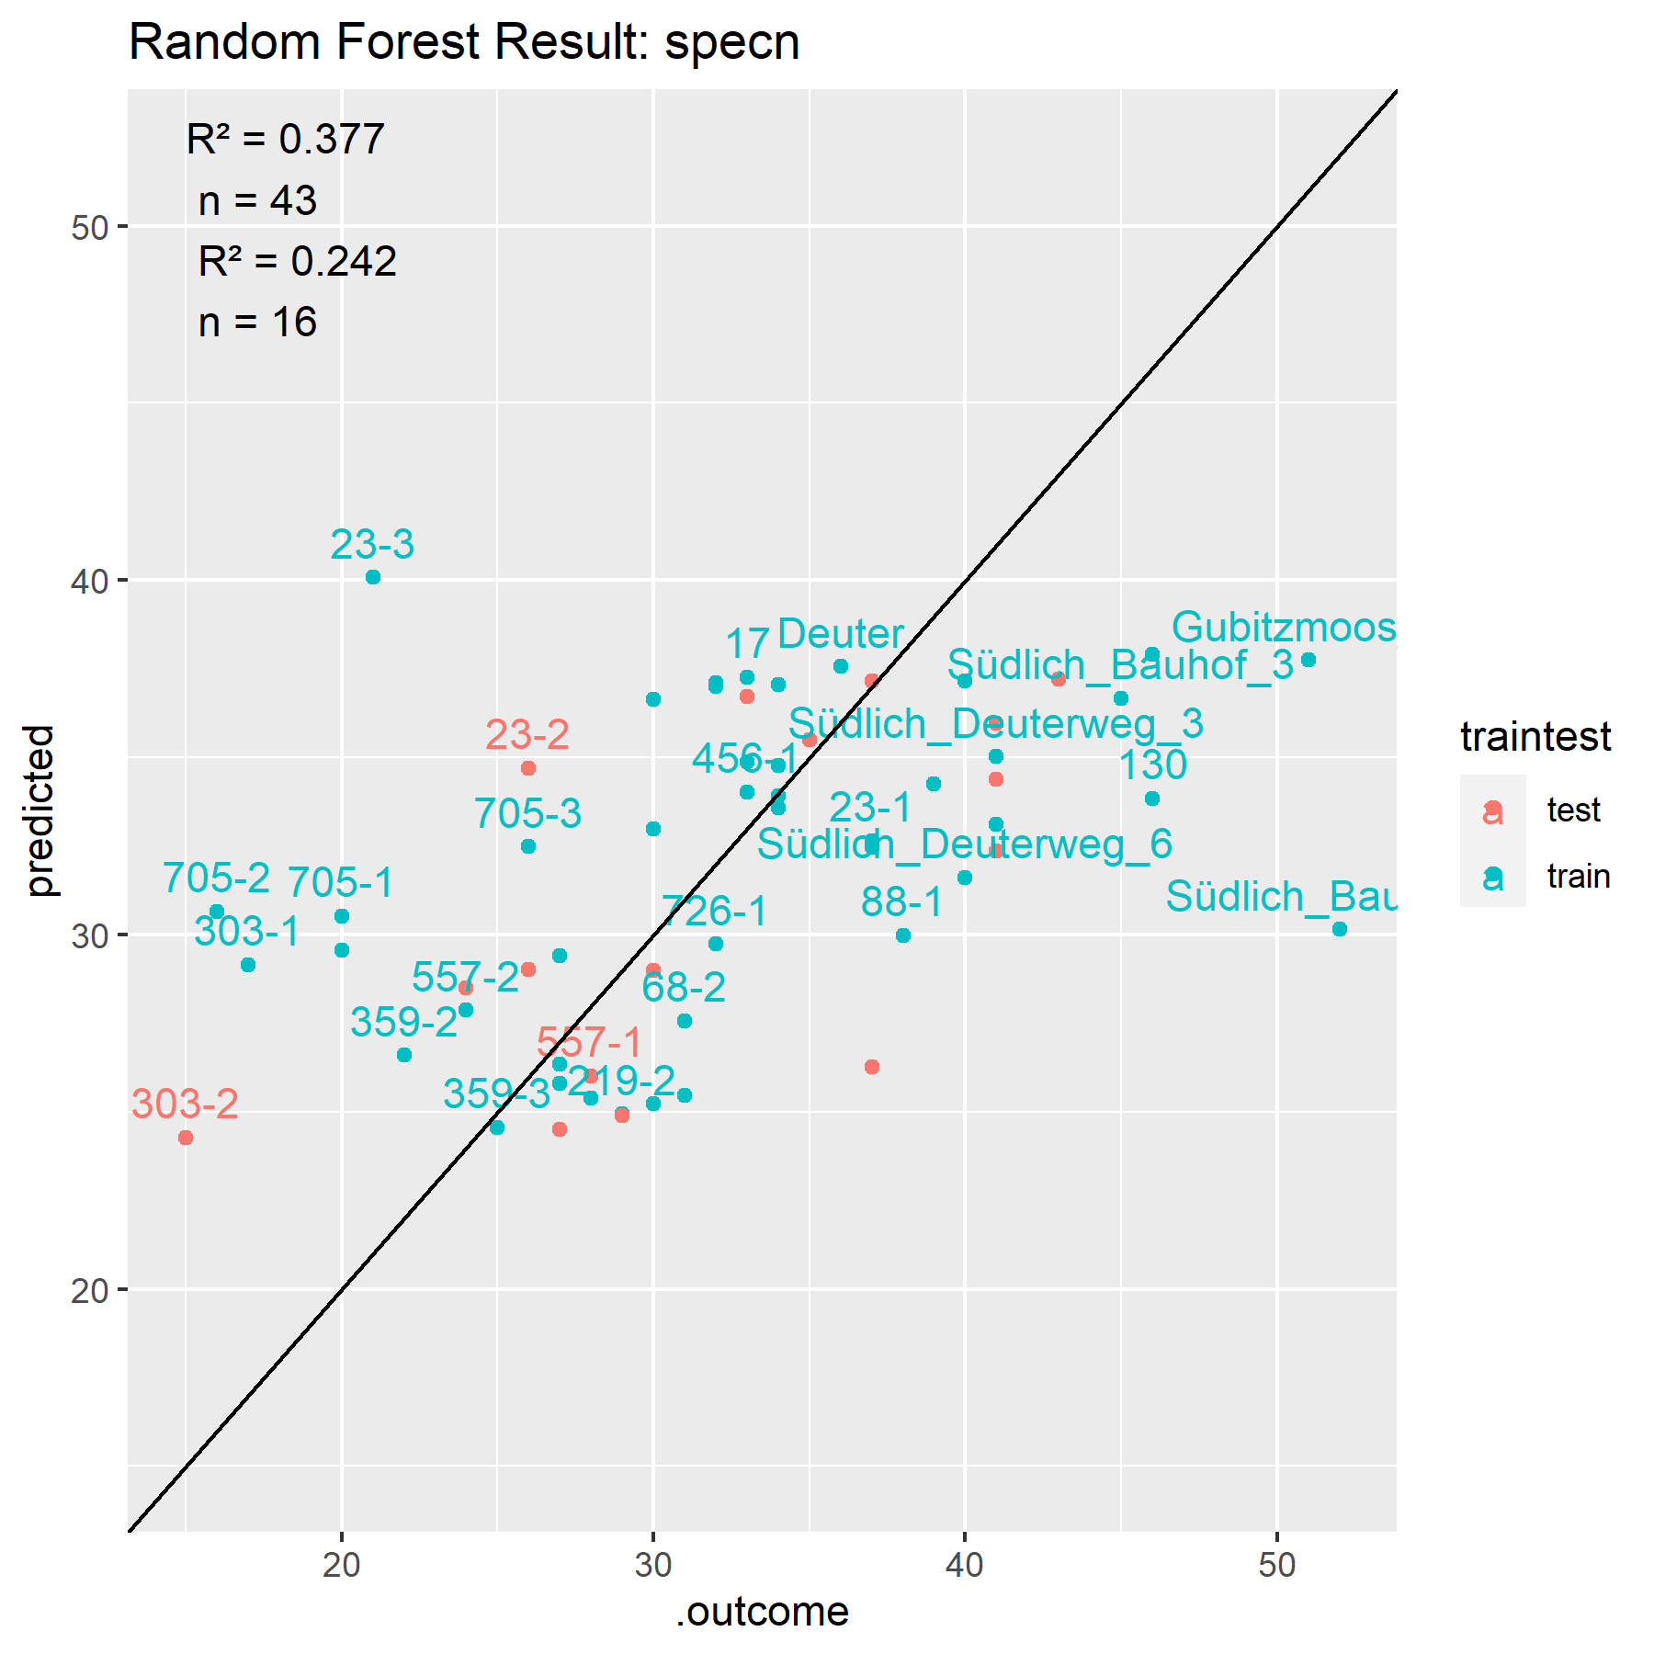
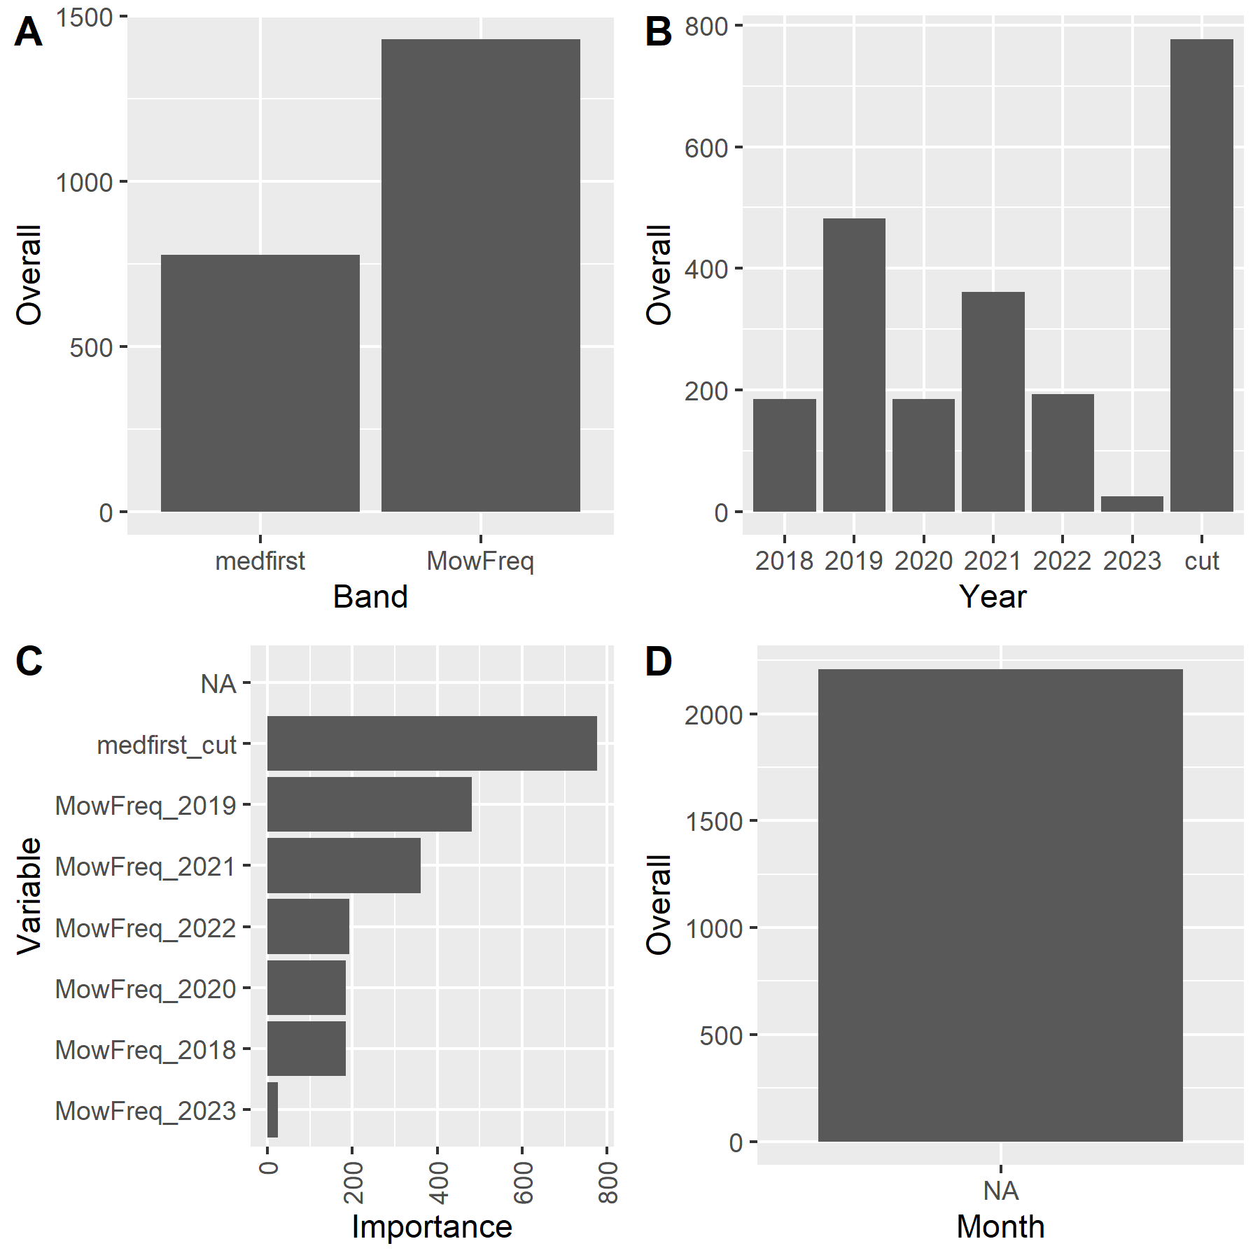
RF trained with Mowing Data only
Notes:
Median DOY of first cut and yearly mowing frequency

Slide 17
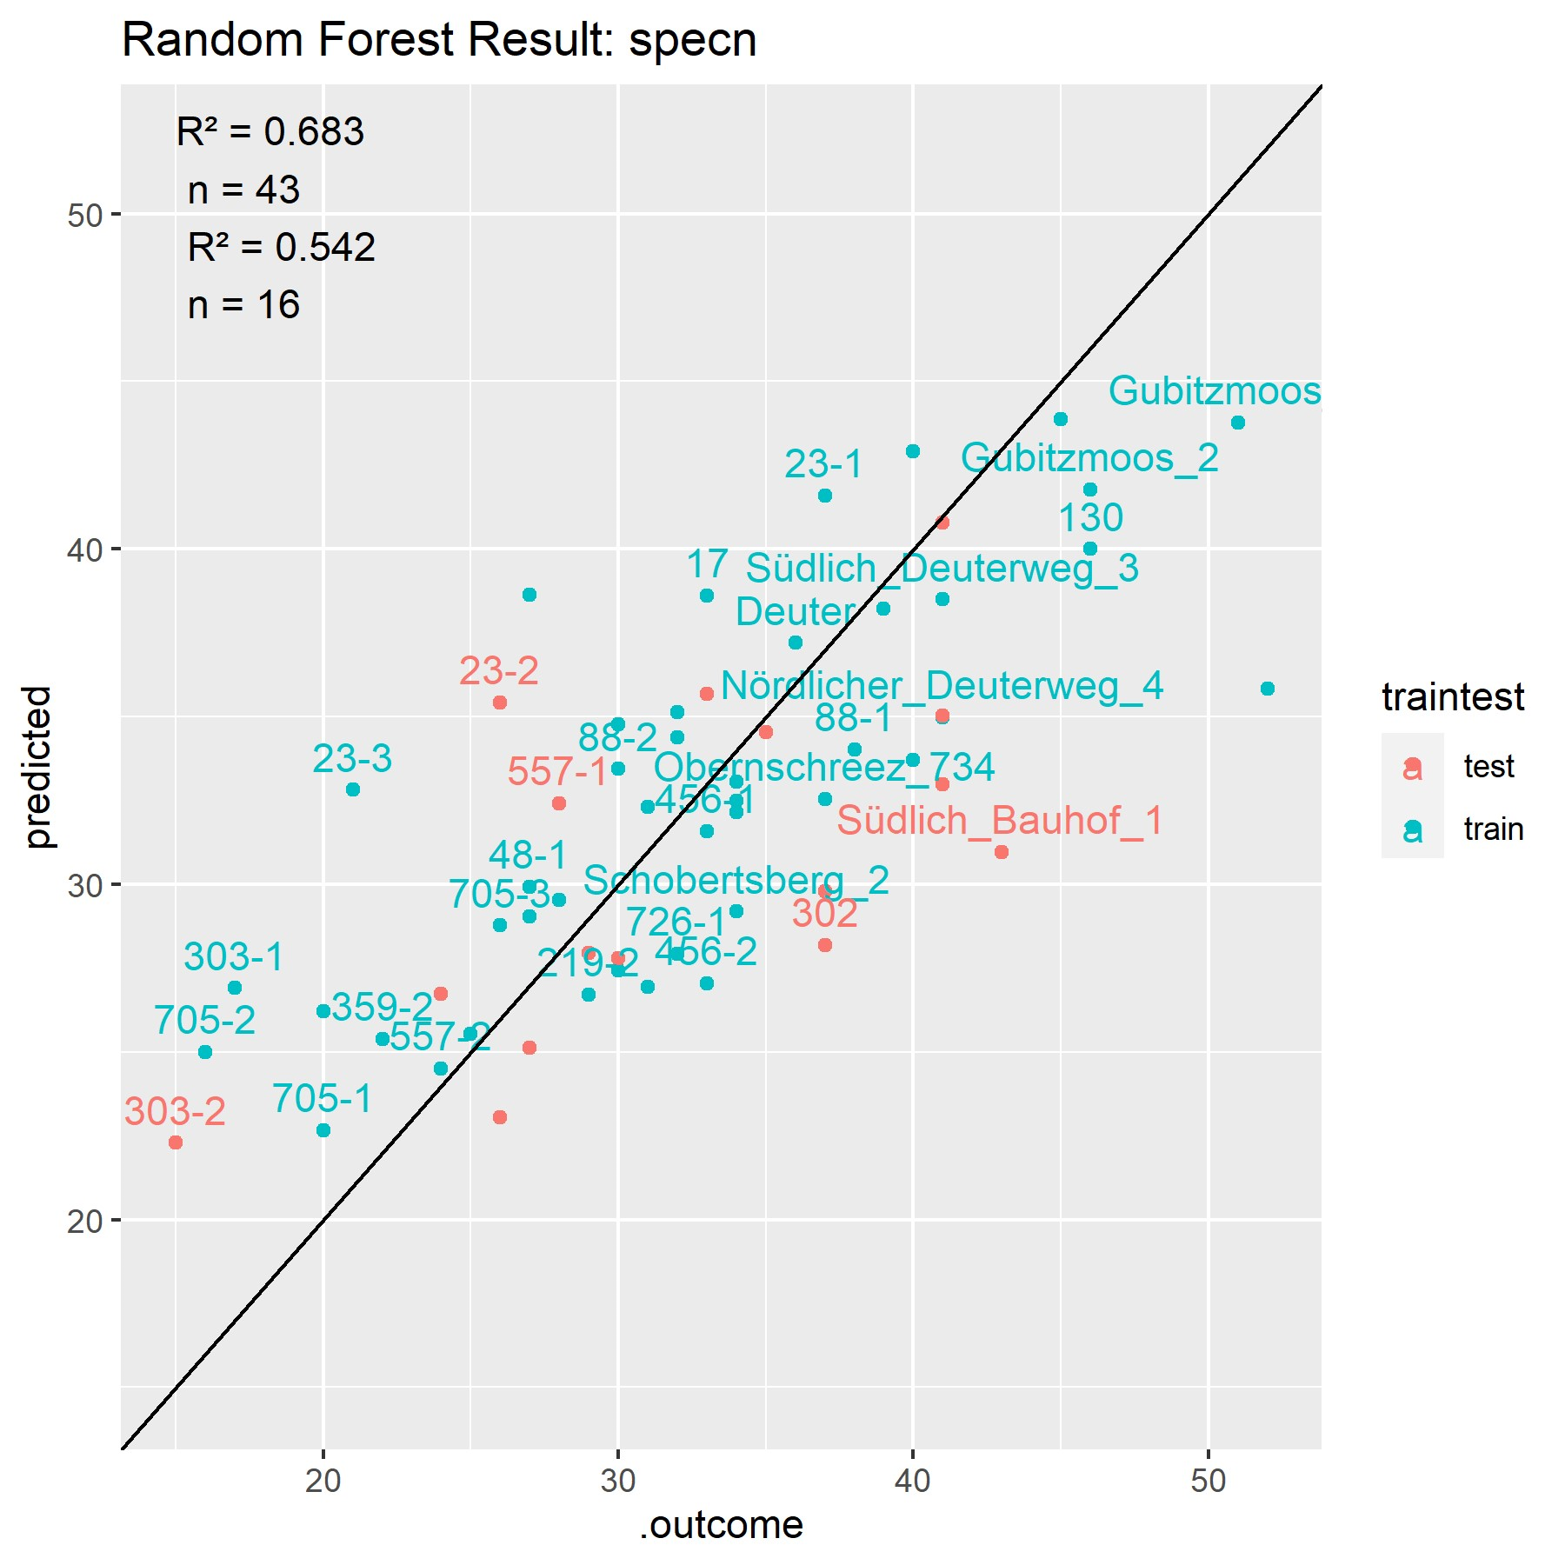
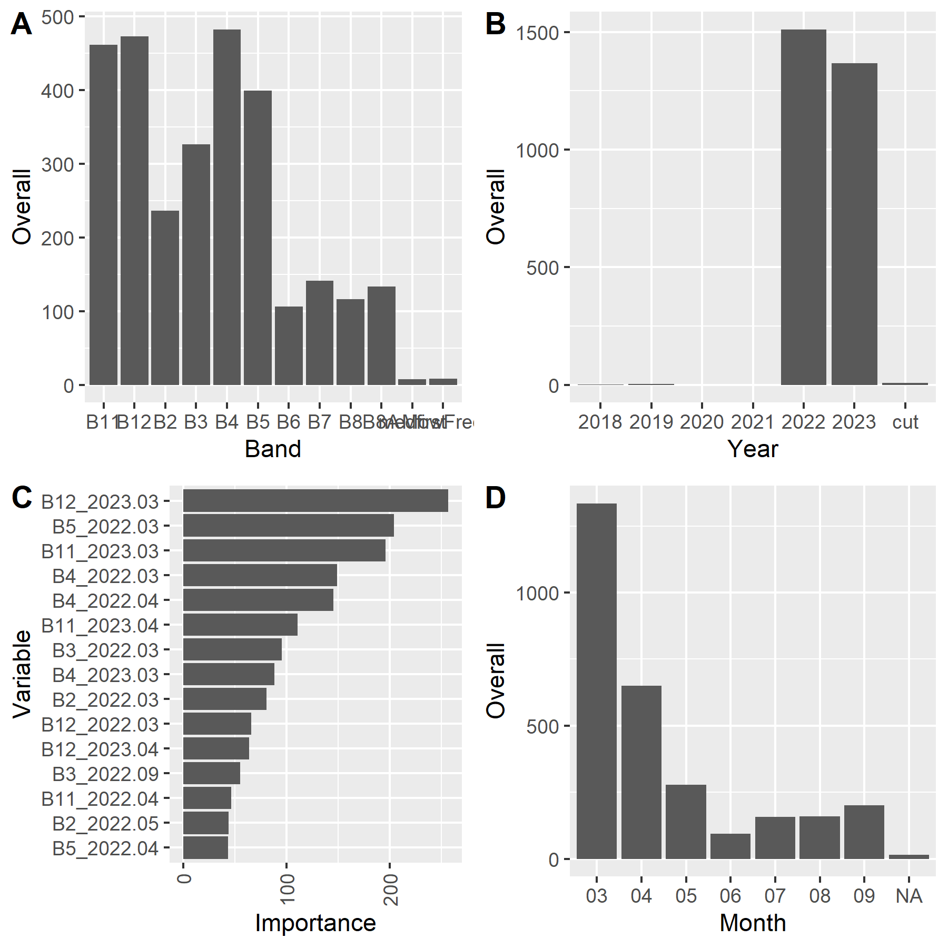
RF trained with Reflectance and Mowing Data

Slide 18
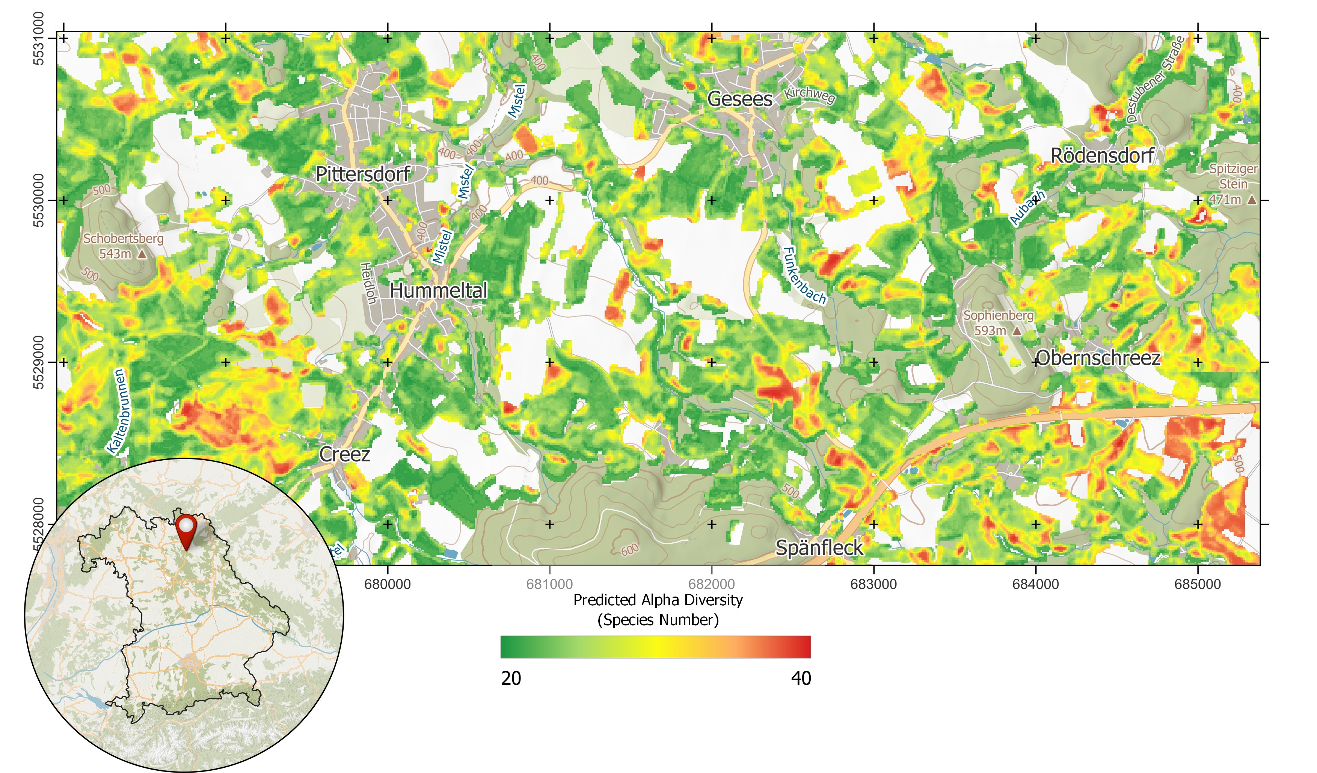
Prediction of Grassland Species Richness into space

Slide 19
Conclusion
Prediction of Overall Species Richness with R² of up to 0.75 → unusually high for this field of application (literature up to 0.42, see Muro et al. (2022)) → Generalisability is still an issue!
Mowing Data does not improve Random Forest model → Variation already represented in reflectance information
Compositing Statistics is not as important for prediction in our study sites → Still important to consider, relevant
Notes:
Grasslands too diverse that model can be used for another area like Ammer catchment
Compositing not as important, because not enough acquisitions per month

Slide 20

Outlook
Measure of spectral Variance in aggregated Pixel as additional Predictor
Neighbouring Land Cover / Land Use for Prediction in Space
Area of Invecos Parcel, Prediction on Parcel Scale?
Release of R package with necessary functions for the presented analysis
https://github.com/Siedrid/Grasslands_BioDiv

Slide 21
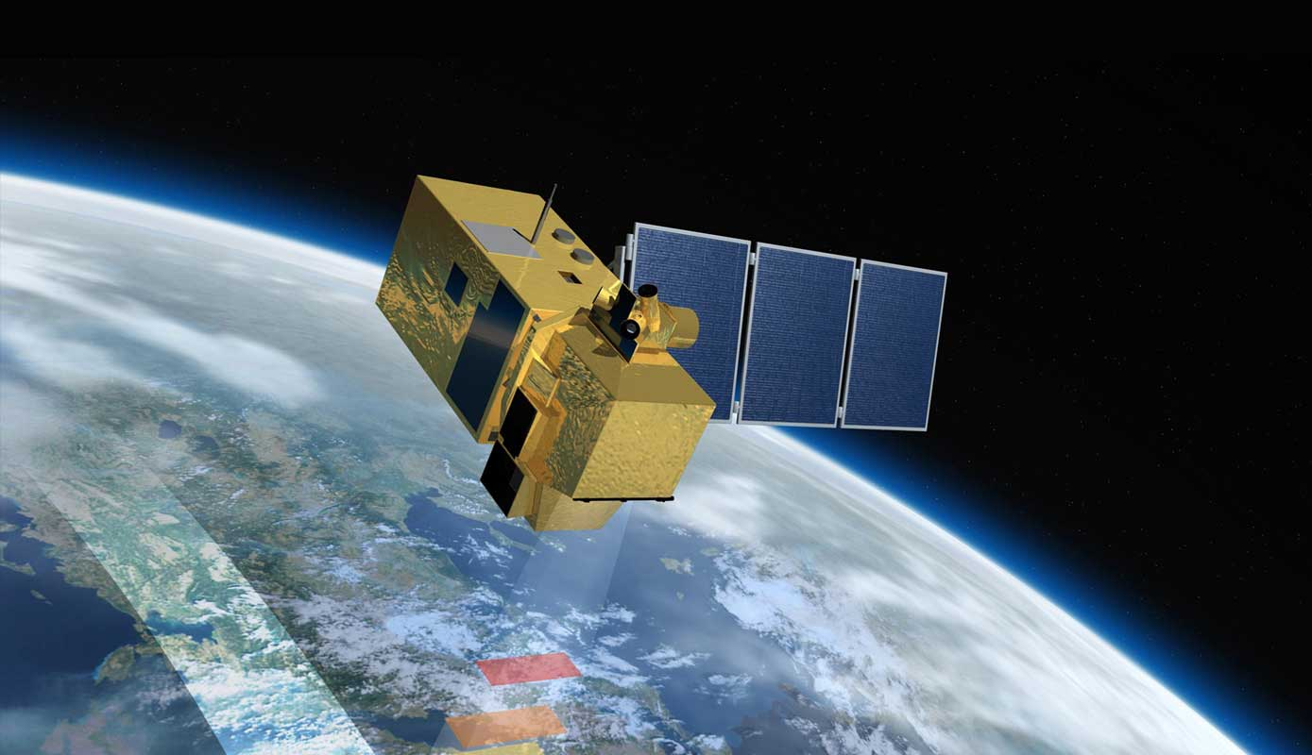

Thank you for listening!
https://researchgate.net/profile/ Laura-Obrecht
https://github.com/Siedrid
laura.obrecht@gmx.de
Notes:
Some contact details

